Slide 1
Employee Data Analysis using Excel
STUDENT NAME: RANJANI T
REGISTER NO: 312208753 (082340BC195020BAC1C45508D77AAE38)
DEPARTMENT: B.COM (GENERAL)
COLLEGE: MEENAKSHI COLLEGE FOR WOMEN

Slide 2
PROJECT TITLE
Employee Performance Analysis based on Departments, Gender and FTE using Excel

Slide 3


AGENDA
Problem Statement
Project Overview
End Users
Our Solution and Proposition
Dataset Description
Modelling Approach
Results and Discussion
Conclusion
3/21/2024 Annual Review

Slide 4

PROBLEM STATEMENT The task is to identify patterns and differences in performance, helping to inform decisions on employee development and resource allocation. The analysis will produce summary statistics, visualizations, and key insights.

Slide 5

PROJECT OVERVIEW
.
The goal is to identify patterns and dispairities to inform decisions on employee development and resource management through summary statistics, pivot tables and visualizations.

Slide 6

WHO ARE THE END USERS? The end users of this employee performance analysis are HR managers, department heads, senior executives and organisational leadership.

Slide 7

OUR SOLUTION AND ITS VALUE PROPOSITION It provides valuable insights for HR and leadership to make data-driven decisions on development, resource allocation, and diversity. The analysis simplifies complex data into clear visualizations, making it accessible to all stakeholders.

Slide 8
Dataset Description The dataset for employee performance analysis comprises Department, Gender and FTE status. Department specifies their work area. Gender denoted employees gender and FTE indicates empoyees efficiency.

Slide 9

THE "WOW" IN OUR SOLUTION By seamlessly integrating performance metrics with departmental, gender and FTE classifications, it provides a clear, comprehensive view of workforce dynamics.
3/21/2024 Annual Review
9

Slide 10
MODELLING
In our Excel-based model for employee performance analysis, we use pivot tables to aggregate data by department, gender, and FTE status. Charts and formulas are employed to visualize and calculate performance metrics, highlighting trends and dispairities.
10

Slide 11
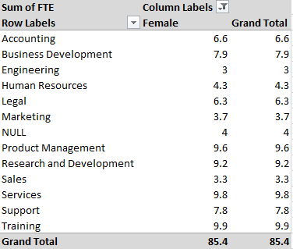
RESULTS 1. TABLE
11

Slide 12

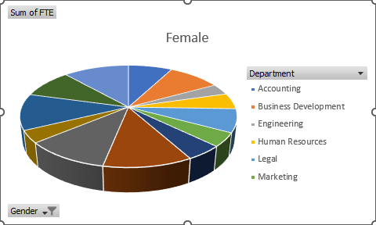
RESULTS 2. PIE CHART

Slide 13
Conclusion In conclusion, the Excel-based analysis highlights performance variations across departments, gender and FTE status. It provides valuable insights for data-driven decision-making, helping to optimize employee management and drive organizational success.

